Slide 1


E-COMMERCE
PRESENTATION
Using smart contract to solve reject talking delivery
Master Do Duy Thanh
6 / 1 / 2023

Slide 2

Group 9 members
Bùi Sĩ Khoa
Huỳnh Minh Quân
Nguyễn Hoàng Thắng

Slide 3



Table of contents
01
Blockchain
02
Smart contract
03
Website

Slide 4


1
Blockchain

Slide 5

What is Blockchain?
Blockchain is a technology that allows the transmission of data securely based on an extremely complex encryption system, similar to a company's ledger, where cash is closely monitored.
Information in the Blockchain cannot be changed and can only be added when there is a consensus of all nodes in the system.
This is a highly secure system against the possibility of data theft.

Slide 6
Blockchain technology is a combination of 3 technologies:
Cryptography: Using public keys and hash functions to ensure transparency, integrity, and privacy.
Peer-to-peer network: Each node in the network is considered as a client and also a server to store a copy of the application.
Game theory: All nodes participating in the system must obey the rules of the consensus game (PoW, PoS…) and are motivated by economic motivation.

Slide 7
Blockchain Features
Increase the working efficiency of the system: the first and most important feature of this software
Better security features: there aren't any loopholes that can be exploited to bring down the system
Stability: a Blockchain system always keep it ledger data in a stable forwarded state.
Faster processing: Blockchain can process data very fast.
Decentralized Platform: The owner will have direct control of the system and transfer his assets to any other person through a virtual key.
Correctness: We will be able to solve the problems related to cheating.

Slide 8
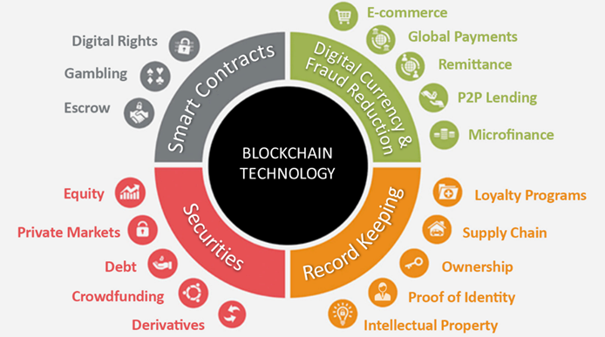
Application of blockchain
Cryptocurrencies
Banking
Asset transfer
Smart Contracts
Supply Chain Monitoring
Voting

Slide 9

Ethereum
Ethereum is a decentralized, open-source blockchain with smart contract functionality

Slide 10
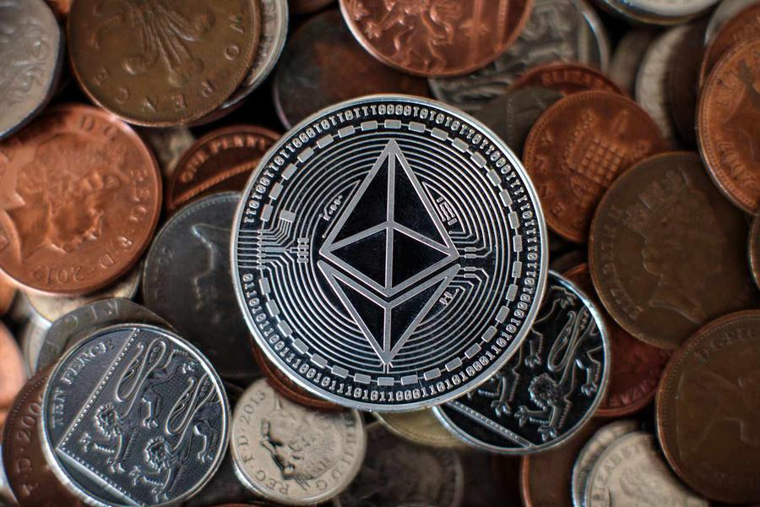
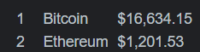
ETH
Ether or ETH is the cryptocurrency generated in accordance with the Ethereum protocol as a reward to miners in a proof-of-work system for adding blocks to the blockchain.
Since the launch of Ethereum, ether as a cryptocurrency has risen to become the second-largest cryptocurrency by market value. It is outranked only by Bitcoin

Slide 11
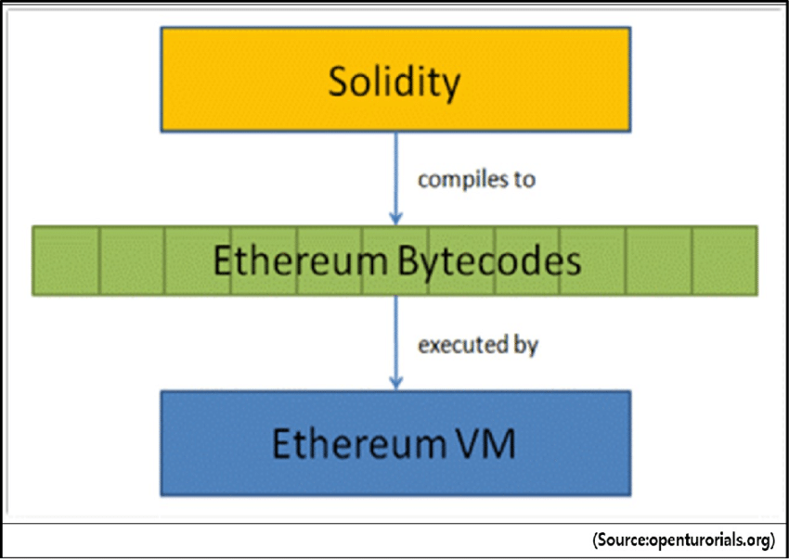
EVM
The Ethereum Virtual Machine (EVM) is the runtime environment for transaction execution in Ethereum. It includes a stack, memory, and the persistent storage for all Ethereum accounts (including contract code). The EVM is stack-based, in that most instructions pop operands from the stack and push the result to the stack. The EVM is designed to be deterministic on a wide variety of hardware and operating systems, so that given a pre-transaction state and a transaction, each node produces the same post-transaction state, thereby enabling network consensus.

Slide 12

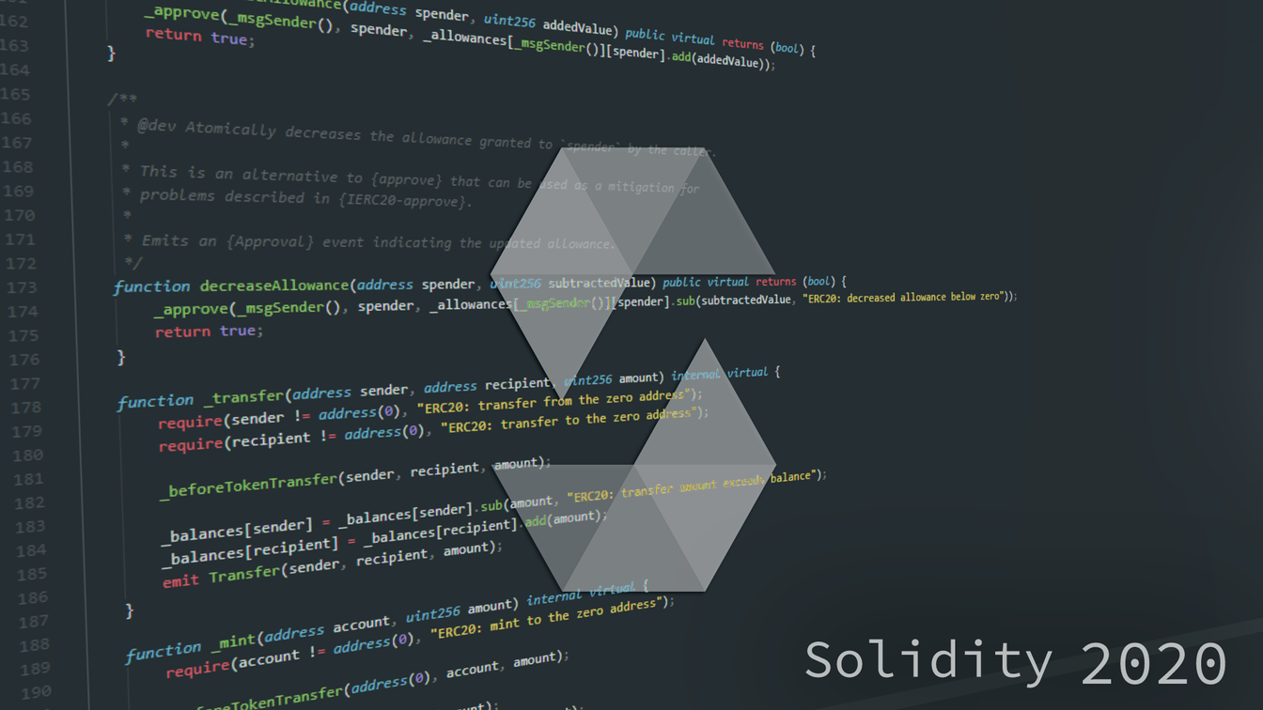
Solidity is an object-oriented programming language for implementing smart contracts on various blockchain platforms, most notably, Ethereum

Slide 13


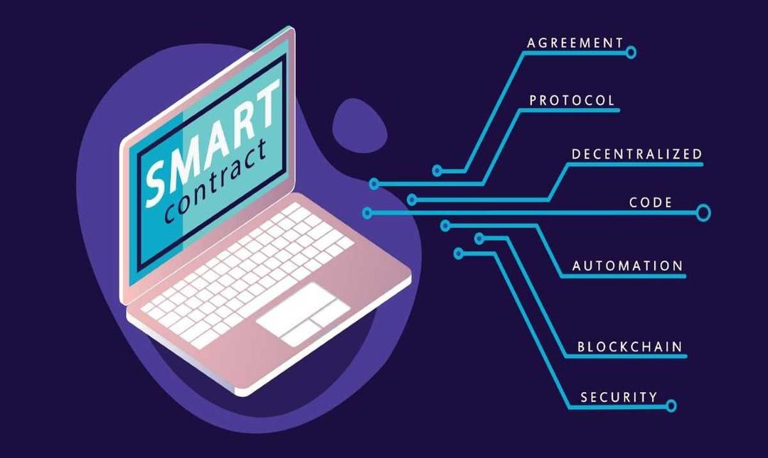
2
Smart contracts

Slide 14

What is a smart contract
Smart contracts are simply programs stored on a blockchain that run when predetermined conditions are met. They typically are used to automate the execution of an agreement so that all participants can be immediately certain of the outcome, without any intermediary’s involvement or time loss. They can also automate a workflow, triggering the next action when conditions are met.

Slide 15


Traditional contracts VS Smart contracts
Traditional
Requires a lot of time to reach agreement between 2 parties
Require both parties to pay the quantities promised on time – manually, which necessitates additional organisational efforts on their part
Far more expensive because of paying for 3rd parties and "hidden fees"
Needs both parties to be present
Time, space, administration, and monitoring are all required
Are more likely to get faulty and manipulated

Slide 16
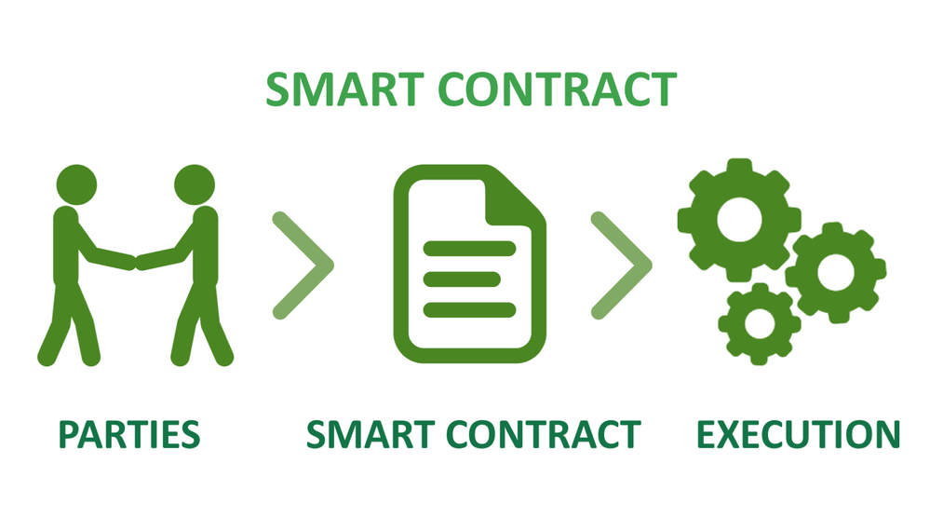
Traditional contracts VS Smart contracts
Smart
Requires much less time to reach agreements since smart contracts are "digital"
The fees are immediately and automatically paid upon reaching an agreement which are also recorded in the smart contract
Does not require the involvement of intermediaries or third parties so the fees are considerably lower
Eliminates the needs for both parties to be present
Happens promptly, safely, and without wasting time or natural resources
Completely automated so It's harder for faults and manipulation to happen

Slide 17

And how does it work

Slide 18
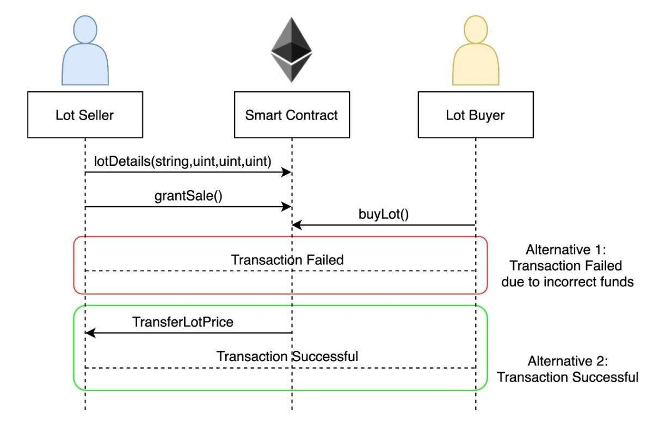
First the seller creates the details of the contracts using lotDetails function
Then the seller upload the product for selling using the grantSale function after that It's added to the smart contract
Buyer buys the product using buyLot function
The smart contract will check the buyer's funds from this point on there will be two consequences:
+ If the buyer pays the incorrect funds then the smart contract will deploy a transaction failed error
+ Else the TransferLotPrice function is executed to give the funds to the seller

Slide 19
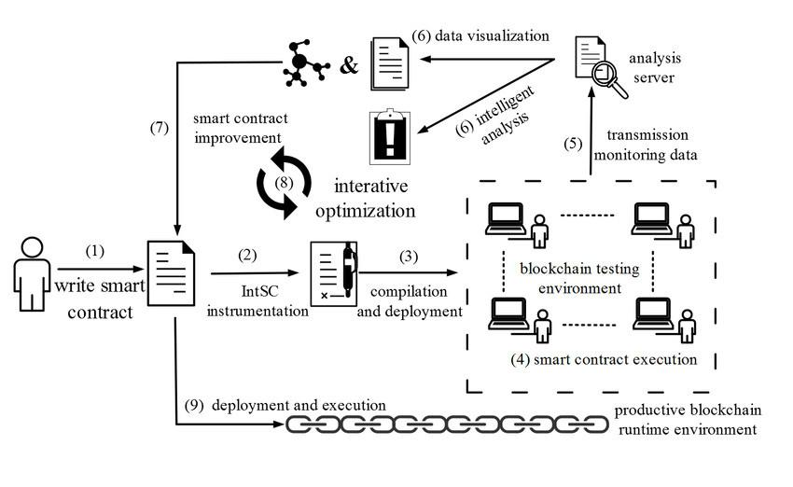
The procedure of smart contract optimization loop
(1) Developer write smart contract using Solidity
(2) Smart contract code is developed on Solidity and instrumented by IntSC script
(3) The instrumented contract code is compiled to bytecode
by SOLC compiler and deployed on blockchain testing environment composed of multiple distributed nodes
(4) The smart contract is executed on the blockchain testing
environment, then the functions’ calling relationships and
relevant metrics such as instruction execution number, time
and gas consumption, are acquired
(5) The monitoring data is transmitted to the analysis server
(6) User can visualize the monitoring data and do intelligent analysis on the contract’s behaviors
(7) The smart contract developer optimizes and revises the
contract according to the feedback
(8) The operations above are repeated iteratively until the
quality of smart contract satisfies the execution requirements
(9) The optimized smart contract is deployed on real productive blockchain runtime environment for execution

Slide 20


Pros and cons
High speed, efficiency and accuracy
Trust and transparency
Security
Negates unwanted fees which creates more saving
Weak enforcement
Hard coded
Bugs vulnerability
Gas prices can get high

Slide 21
Demo

Slide 22



3
Website

Slide 23



About my website
My webstite my website is designed for business an online store of beautiful and full-featured handbags
Everyone also can go to my website to read some news about bag as well daily life
website: https://beaubag.site

Slide 24





Features
Interface: Easy to use
Users can use the website's features easily by using the buttons on the screen
Easy to manage
Easy to statistic
The admin page easily manages customer information, administration, services, invoices.
Users can easily order statistics with high accuracy and efficiency
Easy to maintain, fix errors:
Users can easily fix errors when using a simple way

Slide 25

Demo website

Slide 26
Thank You

Slide 27
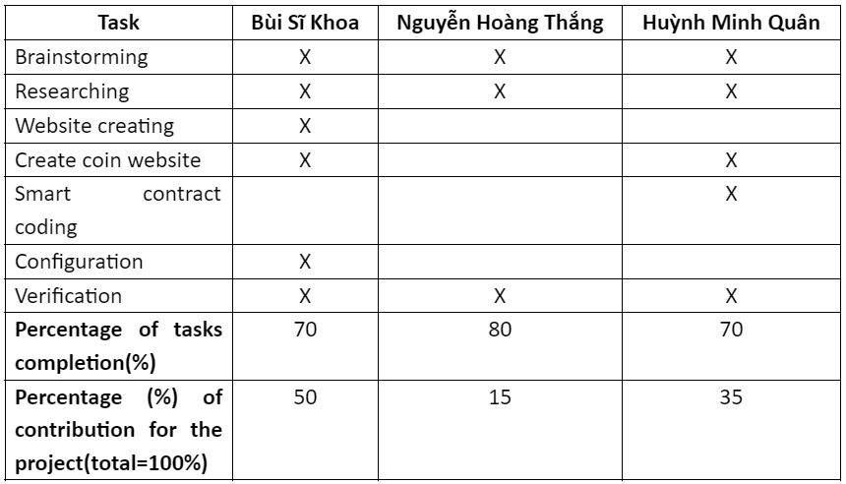
Task assignment table

Slide 28
Link youtube and drive
https://youtu.be/jz1-CyTCClc
https://drive.google.com/drive/u/0/folders/18e6hXJu_ETgyTHp0LXWYTbOEHsAt_Hg5

